Slide 1
Class 4: Deep and Convolutional Neural Networks

Slide 2
Outline
Introduce new layer types: dropout, normalisation, pooling
1D convolution: intuition and examples
2D convolution and kernels
Building deep CNNs & applications
Regularisation, extensions & outlook
[3] [4]

Slide 3

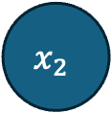
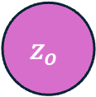
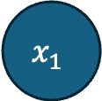
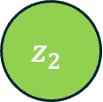
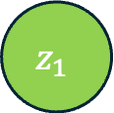

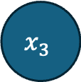

Dense networks: recap
$$x_{1}$$
Each neuron computes a weighted sum of all inputs, adds a bias, and applies a non‑linearity (e.g. ReLU).
Dense layers are fully connected: every input connects to every output, leading to many parameters.
Parameter count grows quickly with input dimension
$$h_{1}=ReLU(z_{1})$$
$$z_{1}$$
$$x_{2}$$
$$z_{o}$$
$$z_{2}$$
$$\hat{y}=σ(z_{o})$$
$$x_{3}$$
$$h_{2}=ReLU(z_{2})$$

Slide 4
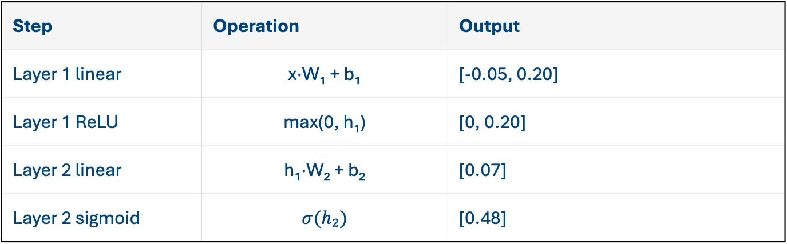
Dense network forward example
Step | Operation | Output
Layer 1 linear | x·W₁ + b₁ | [-0.05, 0.20]
Layer 1 ReLU | max(0, h₁) | [0, 0.20]
Layer 2 linear | h₁·W₂ + b₂ | [0.07]
Layer 2 sigmoid | $$σ(h₂)$$ | [0.48]
Example input: x = [1, 0.5, -1] Weights W₁ (3×2) and W₂ (2×1) chosen for illustration. Biases are zeros for simplicity
The computation proceeds layer by layer: linear combination followed by ReLU to produce non‑negative activations

Slide 5
New neural network layers
We have already met ReLU, sigmoid, and tanh activation functions, but there are many other ways to play with hidden neurons
Dropout: randomly deactivate neurons during training to prevent over‑fitting and scale survivors to keep expectations
Batch normalisation: normalise activations to zero mean and unit variance, then scale and shift with learnable parameters
Pooling: downsample feature maps using max or average operations to summarise local regions and introduce invariance (most useful for convolutions – later in class)

Slide 6
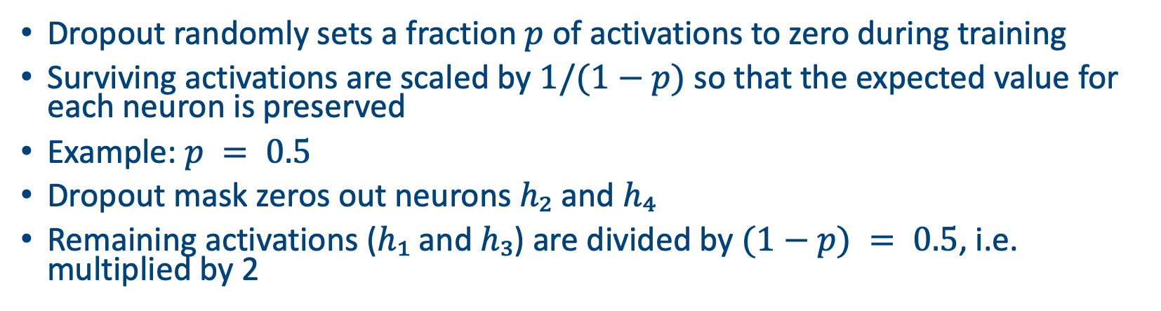
Dropout example
Dropout randomly sets a fraction $p$ of activations to zero during training
Surviving activations are scaled by $1/(1−p)$ so that the expected value for each neuron is preserved
Example: $p = 0.5$
Dropout mask zeros out neurons $h₂$ and $h₄$
Remaining activations ($h₁$ and $h₃$) are divided by $(1−p) = 0.5$, i.e. multiplied by 2
Neuron | Original | Mask | Scaled output
h₁ | 0.50 | 1 | 1.00
h₂ | -1.00 | 0 | 0.00
h₃ | 2.00 | 1 | 4.00
h₄ | 1.00 | 0 | 0.00

Slide 7
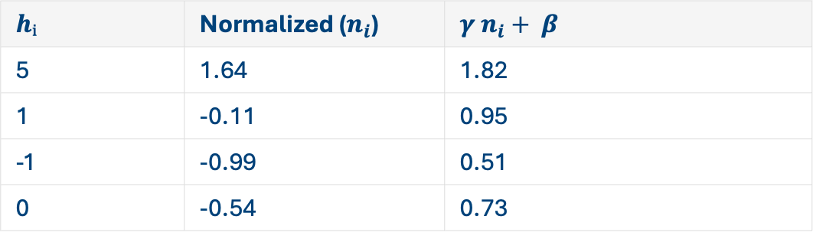
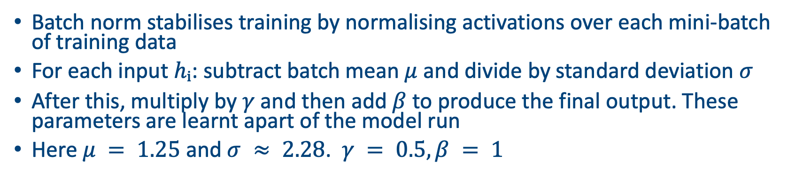
Batch normalisation example
Batch norm stabilises training by normalising activations over each mini‑batch of training data
For each input $hᵢ$: subtract batch mean $μ$ and divide by standard deviation $σ$
After this, multiply by $γ$ and then add $β$ to produce the final output. These parameters are learnt apart of the model run
Here $μ = 1.25$ and $σ ≈ 2.28$. $γ = 0.5, β = 1$
$$hᵢ$$ | Normalized ($n_{i}$) | $$γ n_{i}+ β$$
5 | 1.64 | 1.82
1 | -0.11 | 0.95
-1 | -0.99 | 0.51
0 | -0.54 | 0.73

Slide 8
Convolutional layers

Slide 9
Introduction to Convolutional NNs
Most commonly (but not exclusively) used when the inputs are rectangular
e.g. spatial data, satellite images, sound files
Interested in the relationship between the ‘pixels’ in the image
Try to extract interesting features

Slide 10
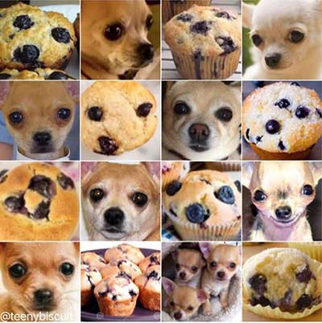
Uses
Image classification: recognise objects in photos (e.g. muffins vs. dogs)
Object detection: locate bounding boxes and labels in scenes
Semantic segmentation: assign a class to every pixel
Audio and speech: 1D convolutions process waveforms for speech recognition
Time series & natural language: sequence models combine convolutions with recurrent layers or transformers

Slide 11
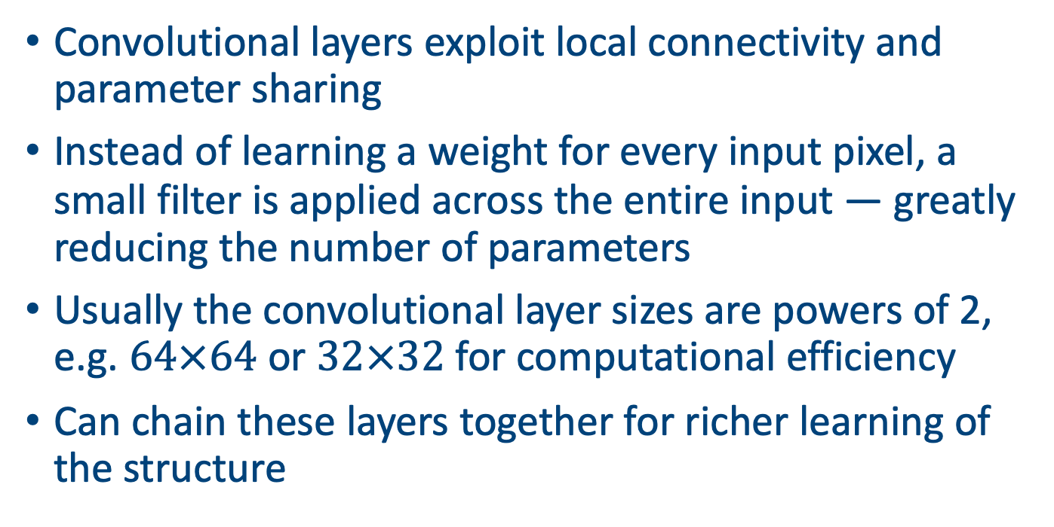
Why convolutional layers?
Convolutional layers exploit local connectivity and parameter sharing
Instead of learning a weight for every input pixel, a small filter is applied across the entire input — greatly reducing the number of parameters
Usually the convolutional layer sizes are powers of 2, e.g. $64×64$ or $32×32$ for computational efficiency
Can chain these layers together for richer learning of the structure

Slide 12
A 1D convolutional layer example
A 1D convolution slides a small filter over a 1D signal
At each position the dot product between the filter and the current window of the signal is computed, producing a new feature
This operation introduces locality and parameter sharing — the same filter is reused across positions
Input
1
2
3
2
1
Kernel
1
0
-1

Slide 13
1D convolutional layer example (cont)
Example: input x = [2, 0, 3, 1, −1], filter w = [1, 0, −1], stride = 1, no padding
The filter slides across the signal and computes a dot product at each position
Output sequence: [−1, −1, 4]
Position | Window | Dot product
1 | [2, 0, 3] | 2×1 + 0×0 + 3×(−1) = −1
2 | [0, 3, 1] | 0×1 + 3×0 + 1×(−1) = −1
3 | [3, 1, −1] | 3×1 + 1×0 + (−1)×(−1) = 4

Slide 14
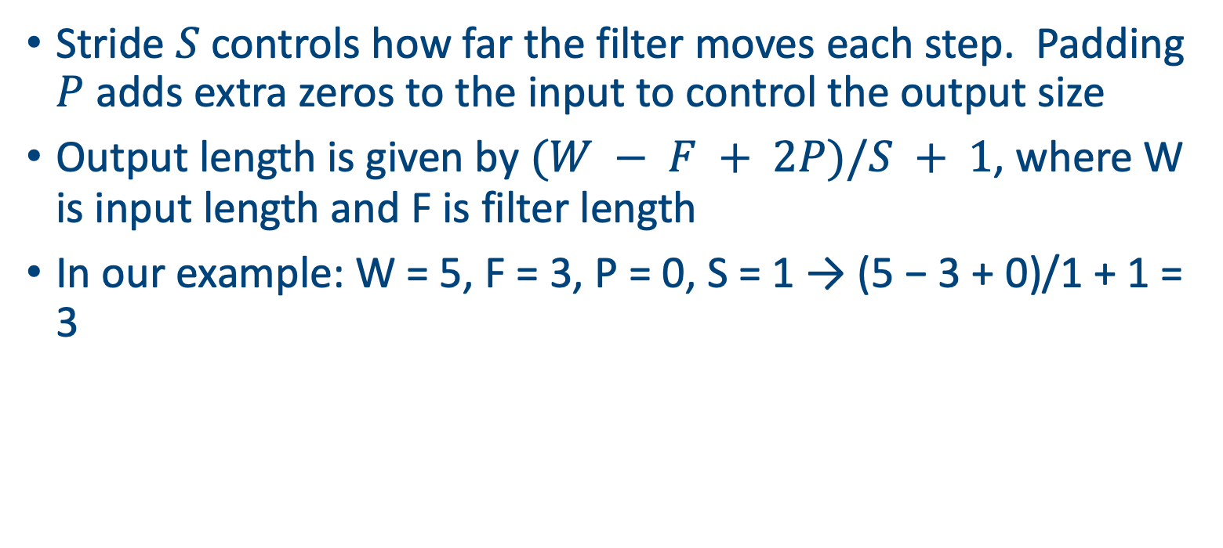
Stride and padding
Stride $S$ controls how far the filter moves each step. Padding $P$ adds extra zeros to the input to control the output size
Output length is given by $(W − F + 2P)/S + 1$, where W is input length and F is filter length
In our example: W = 5, F = 3, P = 0, S = 1 → (5 − 3 + 0)/1 + 1 = 3
Example padded input
0
2
0
3
1
-1
0
Notes:
Rearrange the formula $(W - F + 2P)/S + 1 = L_{out}$.
Answer: $P=1$. $(10 - 3 + 2)/1 + 1 = 10$.

Slide 15
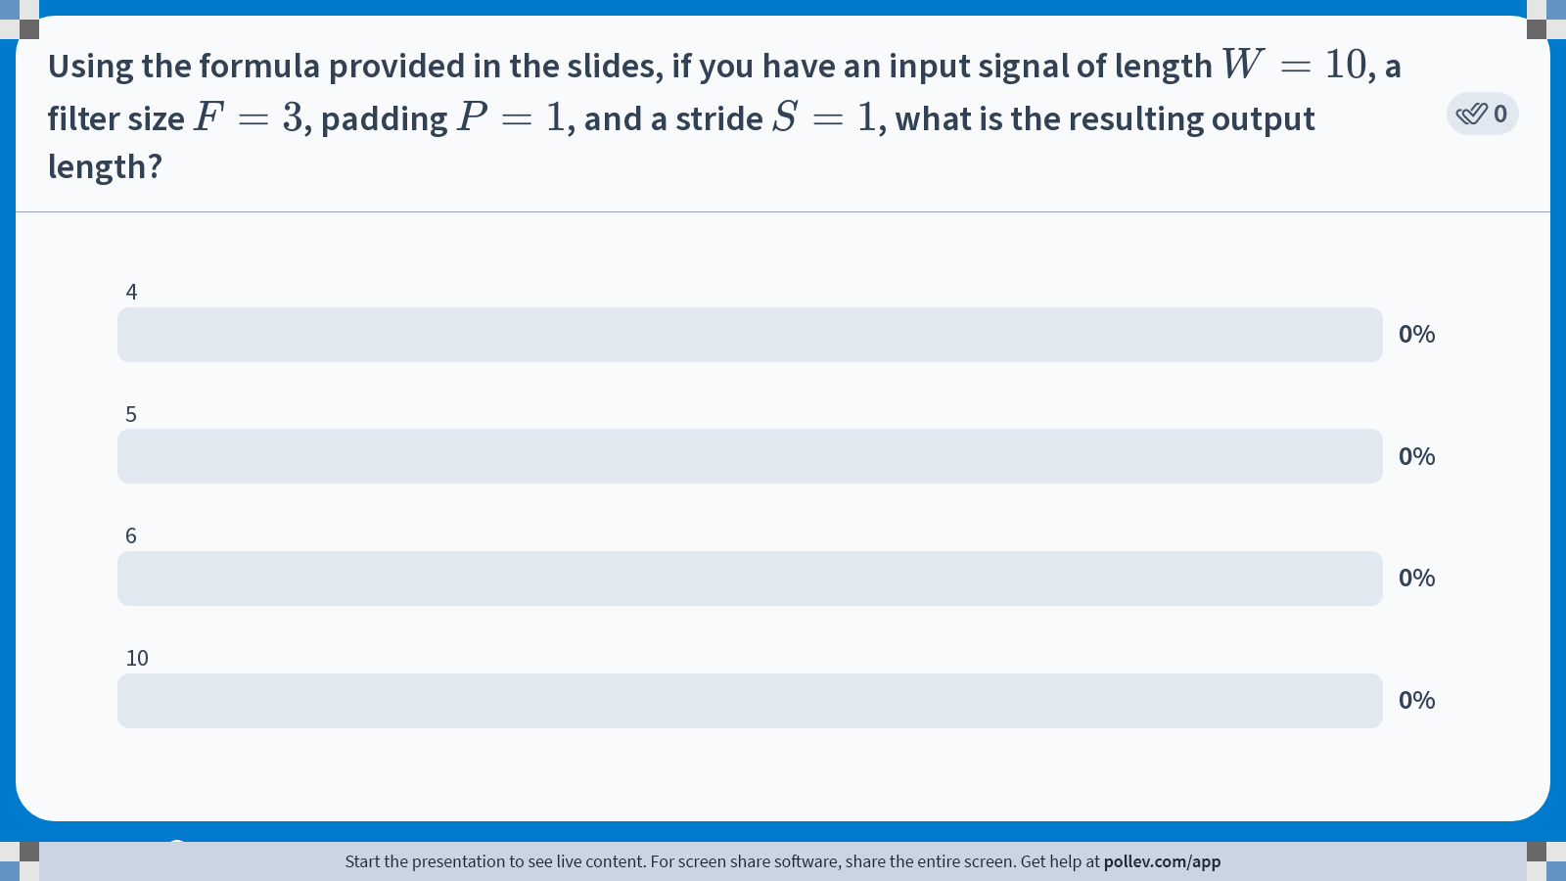
Notes:
Do not modify the notes in this section to avoid tampering with the Poll Everywhere activity. More info at polleverywhere.com/support Using the formula provided in the slides, if you have an input signal of length $$W=10$$, a filter size $$F=3$$, padding $$P=1$$, and a stride $$S=1$$, what is the resulting output length?
https://www.polleverywhere.com/multiple_choice_polls/1uZ6evtXdAIw089vxb3JZ?state=opened&flow=Default&onscreen=persist

Slide 16
1D convolution summary
Locality: filters look at neighbouring elements instead of the entire input
Parameter sharing: one set of weights is reused across the input, reducing parameters
Stride & padding control the output length and allow downsampling
The same ideas extend naturally to higher‑dimensional inputs (2D, 3D, etc.)
Pooling layers (next slide) reduce the dimension still further

Slide 17
Another layer type: pooling
Pooling down-samples feature maps, summarising local patches and reducing spatial resolution
Two common types are max pooling (take the maximum) and average pooling (take the mean)
Pooling introduces translational invariance by discarding precise positional information
Input
2
1
3
2
Max pooled
0
4
5
1
4
5
1
2
0
3
2
3
2
1
2
0

Slide 18
Next: 2D convolutions
Input
In 2D convolutions, a filter (kernel) slides over height and width of an input image or feature map
Each filter has dimensions H×W×D, where D equals the number of input channels. The convolution produces one feature map per filter
Multiple filters are stacked to produce multiple feature maps. The output spatial size depends on the filter size, stride and padding
1
2
1
0
-1
0
2
1
1
Kernel
1
0
0
-1

Slide 19
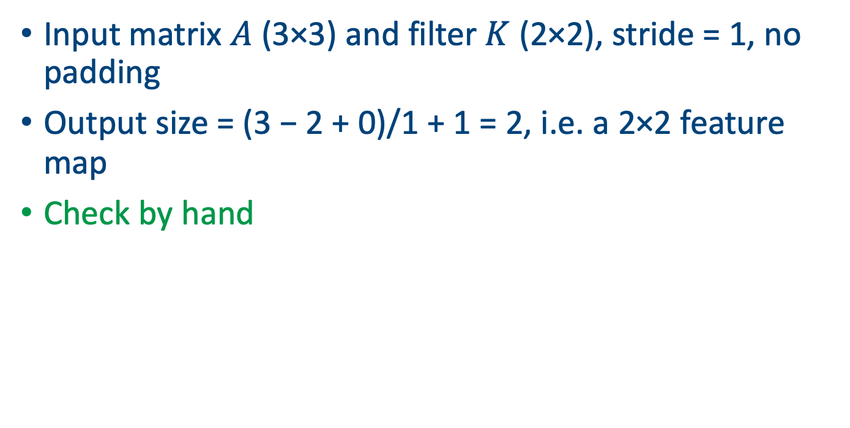
2D convolution example
Input matrix $A$ (3×3) and filter $K$ (2×2), stride = 1, no padding
Output size = (3 − 2 + 0)/1 + 1 = 2, i.e. a 2×2 feature map
Check by hand
A
K
Output
1
2
1
1
0
2
2
0
-1
0
0
-1
-1
2
2
1
1

Slide 20
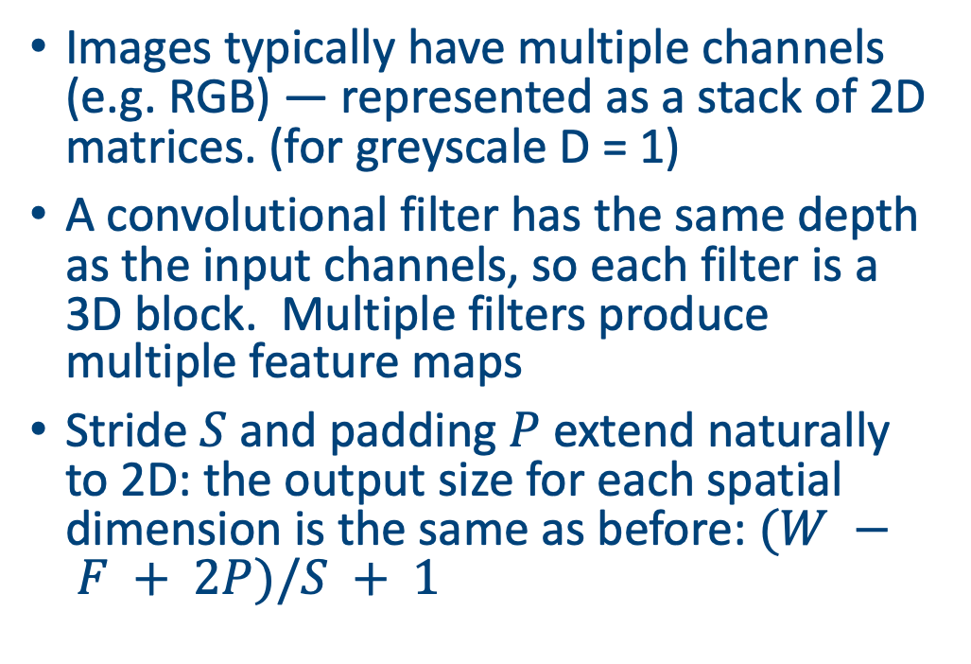
Channels and filters
Input channels
Images typically have multiple channels (e.g. RGB) — represented as a stack of 2D matrices. (for greyscale D = 1)
A convolutional filter has the same depth as the input channels, so each filter is a 3D block. Multiple filters produce multiple feature maps
Stride $S$ and padding $P$ extend naturally to 2D: the output size for each spatial dimension is the same as before: $(W − F + 2P)/S + 1$
Filter
Feature map

Slide 21
Building a CNN
A basic CNN stacks layers in a chosen order, e.g. convolution → activation → pooling → fully connected
Convolution and pooling reduce spatial dimensions while increasing depth. After flattening, a dense layer classifies features
The figure on the right tracks the shape of an example input (8×8) through the network
Any model with enough layers becomes a deep learning NN
8×8 input
Conv, ReLU & pool
Flatten
Dense→output
Notes:
Each filter must match the input depth ($3 \times 3 \times 3 = 27$ parameters per filter). With 10 filters, that is $27 \times 10 = 270$

Slide 22
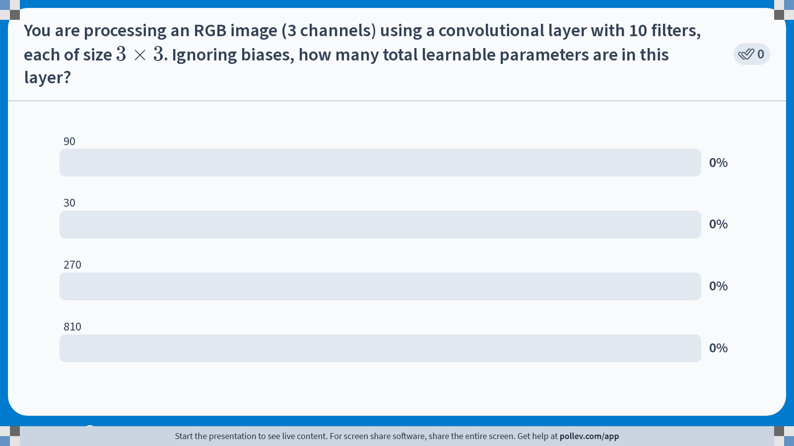
Notes:
Do not modify the notes in this section to avoid tampering with the Poll Everywhere activity. More info at polleverywhere.com/support You are processing an RGB image (3 channels) using a convolutional layer with 10 filters, each of size $$3 \times 3$$. Ignoring biases, how many total learnable parameters are in this layer?
https://www.polleverywhere.com/multiple_choice_polls/P5YHvumIcxuIb8NyWtIP2?state=opened&flow=Default&onscreen=persist

Slide 23
Feature hierarchies
Convolutional networks learn hierarchical features
Early layers detect simple edges and textures
Intermediate layers combine edges into motifs (e.g. corners, curves)
Deeper layers capture high‑level parts and objects
Illustrated on the right are abstract patterns representing different levels of abstraction
Edges
Motifs
Objects

Slide 24
Stitching ideas together
Dropout: mitigates over‑fitting by randomly deactivating units
Weight decay (also known L2 regularisation or dilution): penalises large weights to encourage smoother models
Data augmentation: synthetically enlarge datasets by random cropping, flipping, scaling
Mini‑batch training & optimisation: stochastic gradient descent (SGD) with Adam optimiser improves convergence
Early stopping: monitor validation loss and stop training when performance no longer improves

Slide 25
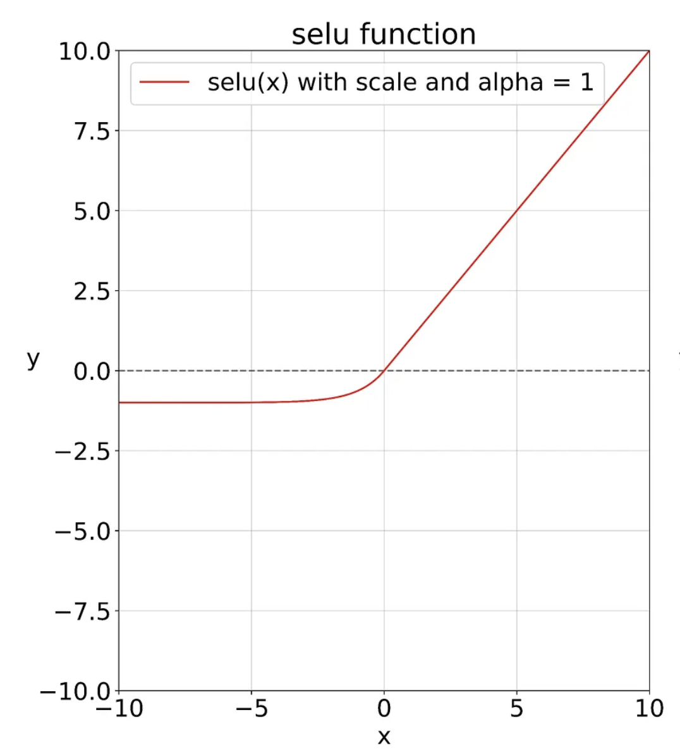
Some cool NN variants
Activation variants: Leaky ReLU allows a small gradient for negative inputs; ELU and SELU reduce vanishing gradients; Softmax maps outputs to a probability distribution for classification
Normalisation variants: Layer norm normalises across features within one example; Group norm normalises within groups of channels; Instance norm for style transfer tasks
Dropout variants: Spatial dropout drops entire feature maps; Shake‑Drop perturbs activations stochastically
Notes:
Scaled Exponential Linear Unit and ELU stands for Exponential Linear Units
ELU = f(x) = x if x>0 or a * (exp(x) – 1) if x < 0
SELU = f(x) = s*x if x>0 or s*a * (exp(x) – 1) if x < 0

Slide 26
Pooling variants
Average pooling: computes the mean of each patch, reducing noise
Global average pooling: replaces the fully connected layer by averaging over the entire spatial dimension per channel
Strided convolution: downsampling can also be achieved by using a stride > 1 instead of separate pooling layers
Adaptive pooling: output size is specified instead of window size, automatically choosing kernel size and stride

Slide 27
A technical aside
Convolution can be reinterpreted as a matrix multiplication by unrolling the input into patches (im2col) and flattening the filter
This representation allows us to leverage highly optimised matrix multiplication routines (e.g. BLAS) but at the cost of increased memory
Illustration: 2×2 filter applied to a 3×3 input yields a Toeplitz matrix of size 4×9 multiplied by the flattened filter vector
Illustration on board

Slide 28
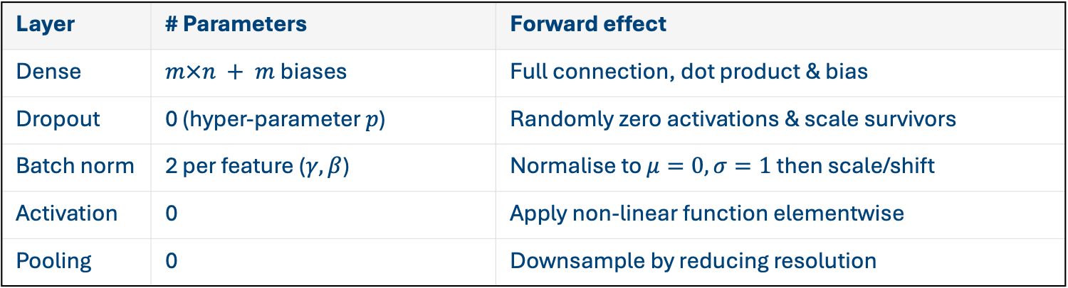
Layer types
This table summarises the roles of some layer types, the number of learnable parameters they add, and how they transform activations during the forward pass
Layer | # Parameters | Forward effect
Dense | $m×n + m$biases | Full connection, dot product & bias
Dropout | 0 (hyper‑parameter $p$) | Randomly zero activations & scale survivors
Batch norm | 2 per feature ($γ, β$) | Normalise to $μ=0, σ=1$ then scale/shift
Activation | 0 | Apply non‑linear function elementwise
Pooling | 0 | Downsample by reducing resolution

Slide 29
Implementation in Pytorch
Vectorised code is critical for efficient deep learning. Use established frameworks (e.g. PyTorch) that implement convolutions with GPU acceleration
import torch.nn as nn
class SimpleCNN(nn.Module):
def __init__(self):
super().__init__()
self.conv1 = nn.Conv2d(in_channels=1, out_channels=8, kernel_size=3)
self.pool = nn.MaxPool2d(kernel_size=2, stride=2)
self.fc1 = nn.Linear(8 * 3 * 3, 10)
def forward(self, x):
x = nn.functional.relu(self.conv1(x))
x = self.pool(x)
x = x.view(x.size(0), -1)
x = self.fc1(x)
return x

Slide 30
Common CNN architectures
LeNet (1998): early handwritten digit recogniser; 5×5 filters, tanh activations
AlexNet (2012): deeper nets with ReLU, dropout and 3×3 / 11×11 conv layers; won ImageNet competition
VGG (2014): very deep (16–19 layers) using only 3×3 convs and 2×2 pooling
ResNet (2015): introduces skip connections to ease training very deep networks (up to hundreds of layers)
Notes:
Skip connections (also called residual connections) are links in a neural network that bypass one or more layers and feed the input of a layer directly into a later layer.
Instead of passing data strictly layer by layer in sequence, you "skip over" intermediate transformations and add (or sometimes concatenate) the earlier signal to the later output.
Why are they used?
Solve vanishing gradient problem By providing a shorter path for gradients during backpropagation, skip connections help signals propagate more effectively in very deep networks.
Stabilize training They make optimization easier because the network can "choose" to learn the identity function (just pass information forward) if deeper transformations are not useful.
Improve accuracy They allow the model to combine both low-level and high-level features, which is especially useful in computer vision and sequence models.

Slide 31
Summary
Dense networks connect everything, but convolutions exploit locality and sharing to scale to high‑dimensional inputs
Layer types such as dropout, batch norm, activations and pooling enable training deeper networks, stabilise learning and improve generalisation
Convolution extends naturally to 2D inputs with multi‑channel filters; stride and padding control output shapes
Building blocks combine to form deep CNNs capable of recognising complex patterns in images, speech and beyond
Continuous innovation (activations, normalization, architectures) and regularisation are key to advancing the state of the art

Slide 32
Next class
Run through D2C3_code.ipynb

Slide 33
Afternoon session instructions
Use some of the data sets in the data directory (or download your own)
Pick a variable and get an LLM to help you write a deep learning model with convolutional layers in Pytorch to predict a response variable from some covariates
Advanced: try to find some satellite images of Ireland (use EUMetSat?) over time and see if you can use a model identify changes
Present your ipynb file in 5 minutes

